Slide 1
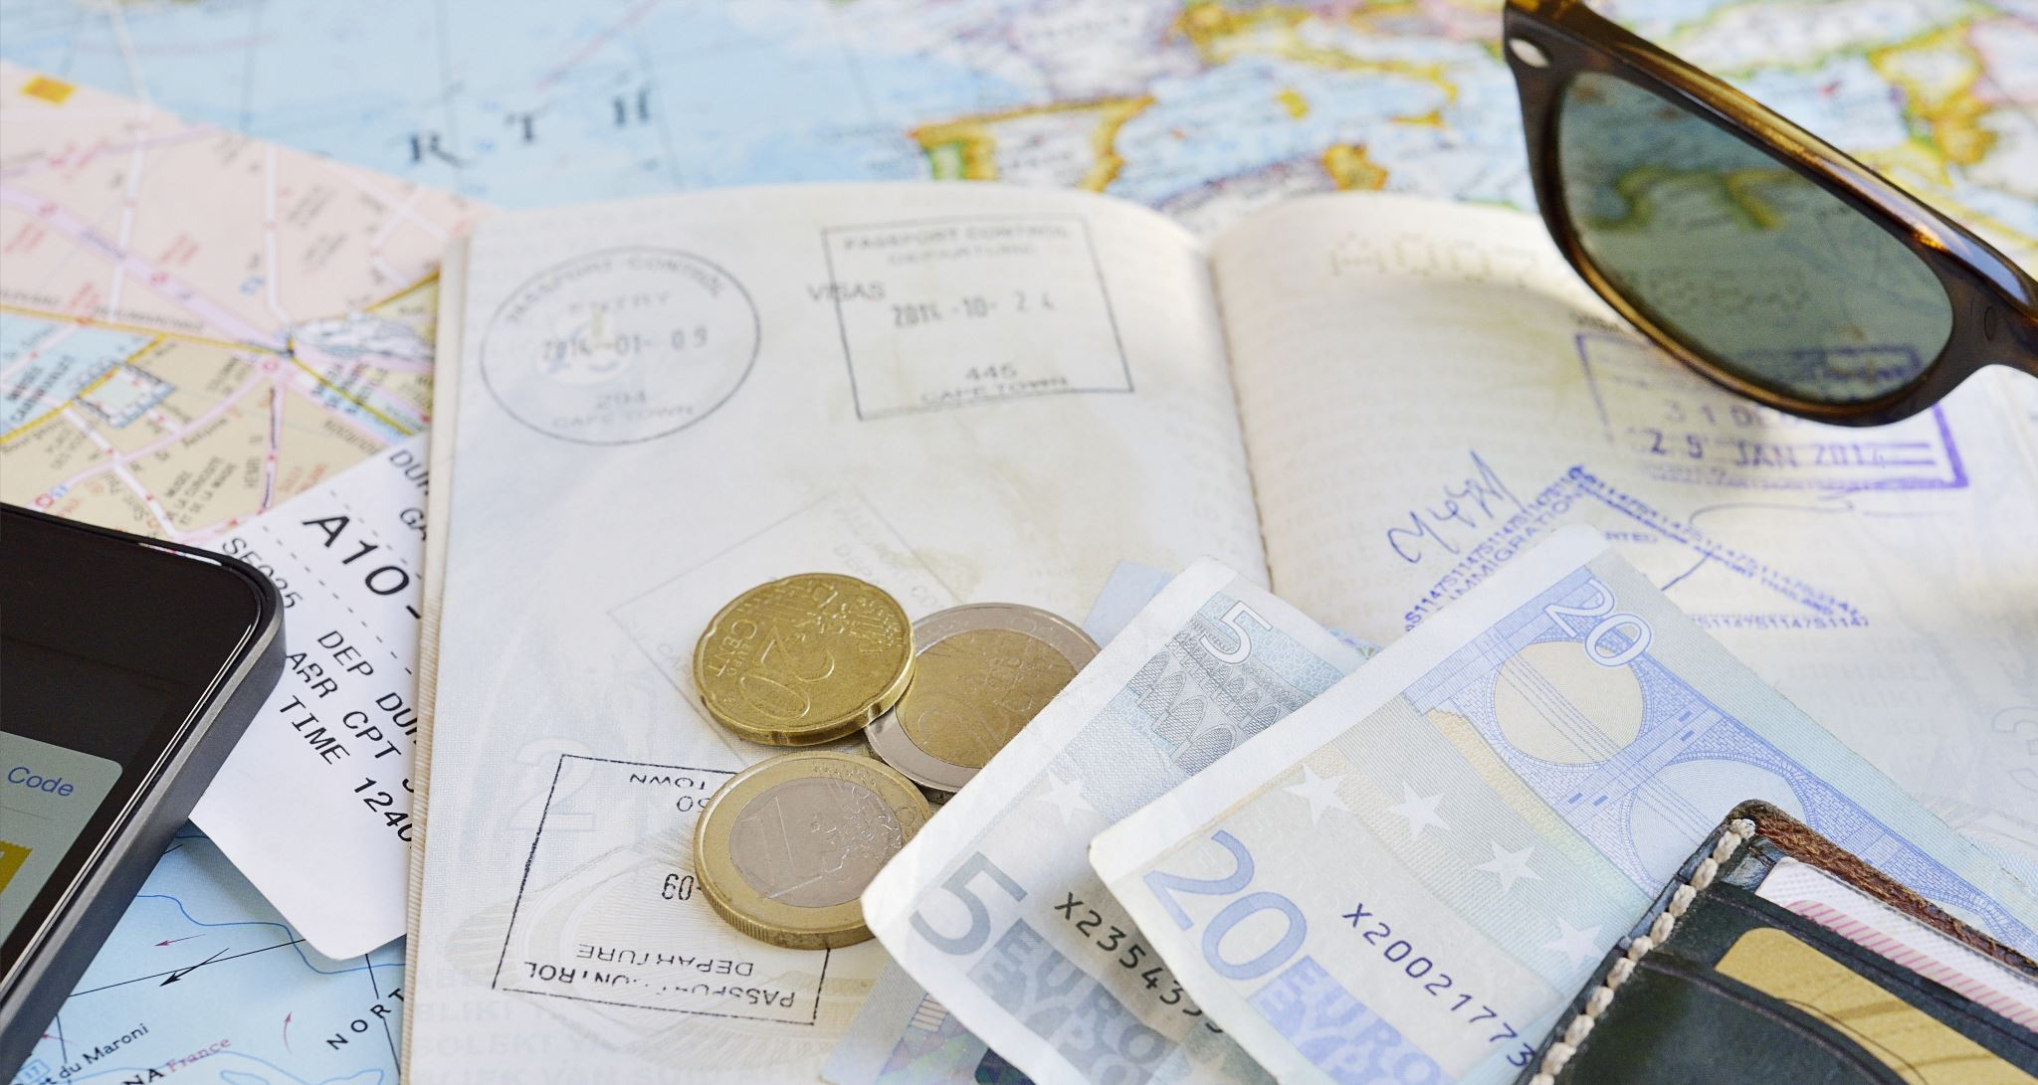
European Tourist Travel
Daniel Sterling
Brian Marowsky
Chandler Foster
Khalil Locke

Slide 2
About our Dataset
Our data provides us with various components of travel through Europe to help us understand how people prefer to travel in the countries and cities.
How do they travel to their region?
What type of place to they prefer to stay in?
Why did they travel to that city?

Slide 3
Modes Of Travel
Flight
Car
Bicycle
Bus
Train

Slide 4
Accommodation Type
Hotel
Airbnb
Camping

Slide 5
Main Purpose
Leisure
Business
Family

